Slide 1
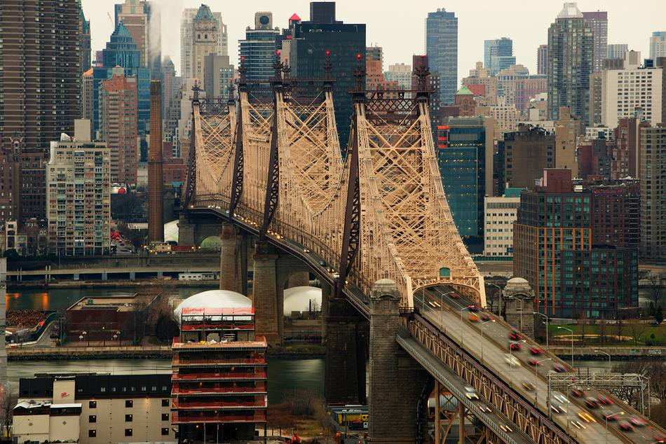
TOP TOURIST DESTINATIONS IN QUEENS, NEW YORK
IBM DATA SCIENCE CAPTONE PROJECT
AUTHORED BY: OLUSOLA ADEKUNLE
August
2019

Slide 2
INTRODUCTION
Founded in 1683, Queens is the one of the lively, vibrant and largest borough in New York. Queens Borough is located on Long Island cross the East River from Manhattan with notable tourist attractions like; Flushing Meadows-Corona Park or the Queens Botanical Garden, the park’s Queens Museum is known for the "Panorama," a building-for-building model of New York City, Nearby Citi Field is the stadium of pro baseball team, the Mets and many more.

Slide 3
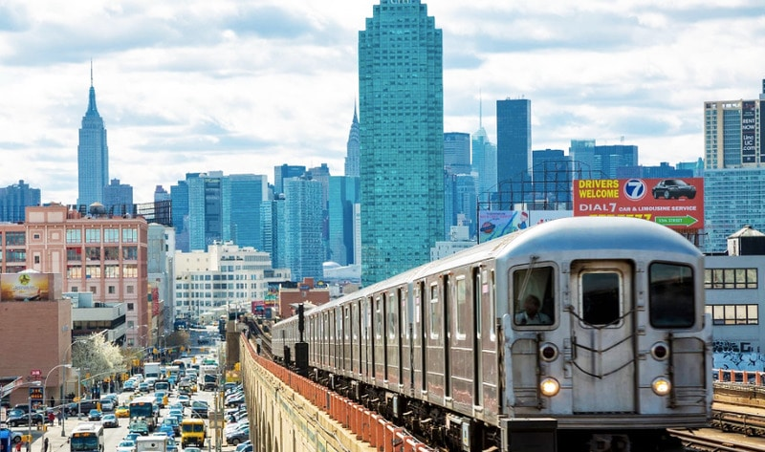
BUSINESS PROBLEM
How can Queens further expand economically?
Over the years, there have been increasing number of people visiting the borough and realizing what a great destination it is. There's history, culture, views, and food without the high prices as seen in other New York borough and this will make every visit a memorable one.

Slide 4
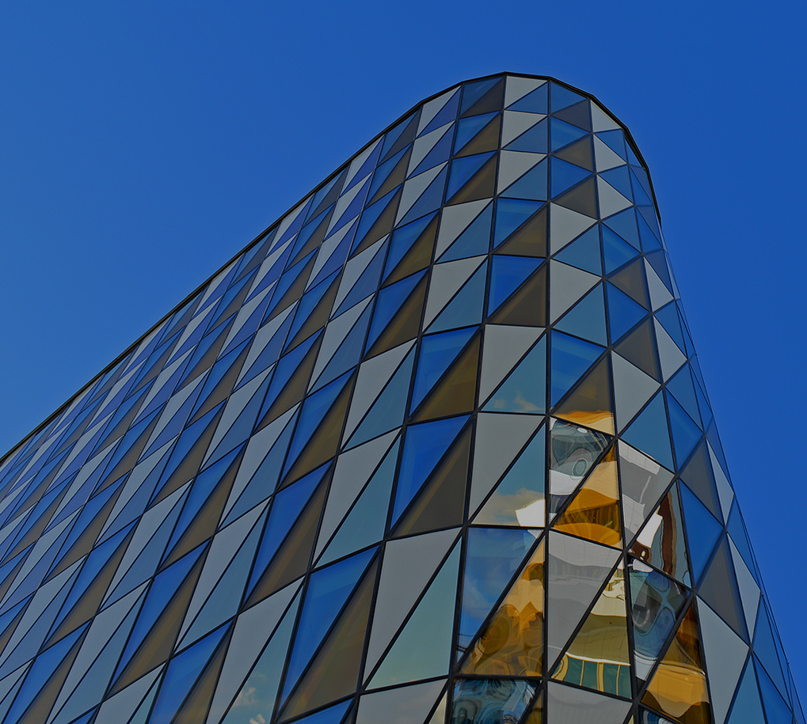
DATA
DATA
While exploring the diversity of the Queens, I required
1. Neighborhoods in Queens. This define the scope of the project.
2. Latitude and Longitude coordinates of those neighborhood. This is required to plot maps and provide venue data.
3. Queens public spatial data

Slide 5
DATA
DATA SOURCES
Queens data shows list of Queens neighborhood together with spatial locations
https://geo.nyu.edu/catalog/nyu-2451-34572
Foursquare venue data

Slide 6
METHODOLOGY
The approach took in this analysis has been categorized under the following
Data segmentation
Data transformation with help of pandas
Data categorization with Foursquare venue data
Venue Category frequency examination
Venue and neighborhood clustering

Slide 7
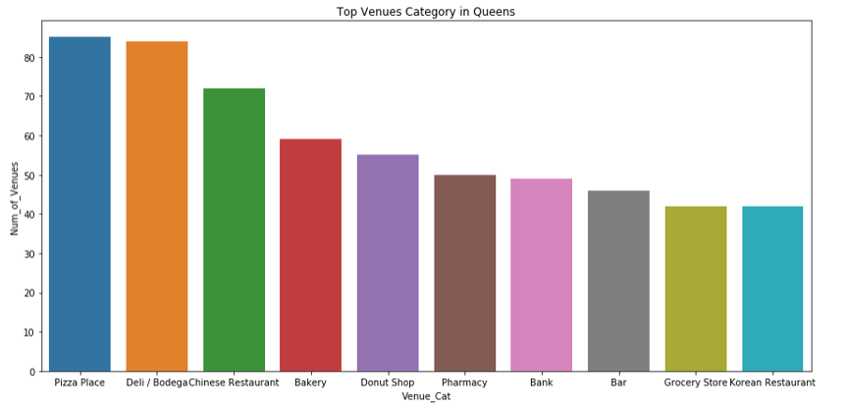
RESULTS
This shows the top 10 venue categories in Queens, more or less a catchment place for intending visitors and individual looking for opportunity to start a business in this neighborhood. Evidently there are quite number of pizza places due to its high demand and popularity of this savory dish.

Slide 8
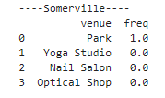
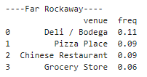
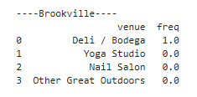
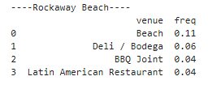
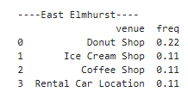
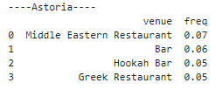
RESULTS
Venue Frequencies in Neighborhoods
This analysis has also shown top venue to visit by neighborhood. The summary below shows the frequencies of these venue by neighborhood.

Slide 9
DISCUSSION
Exploratory analysis shows that Astoria, Sunnyside Gardens, Jackson Heights, Woodside are the most vibrant neighborhoods in Queens due to the number of venues in each of this neighborhood. This apparently mean visitors and tourist are attracted to these neighborhoods. These neighborhoods among other things have high number of Museums, restaurants, ice cream shops, gyms and gourmet.

Slide 10
DISCUSSION
However, some neighborhood shows very low number of venues for anyone intending to visit Queens, but this analysis has shown it’s an opportunity to create business for such neighborhood.
Examples of these neighborhood are; somerville, Brookville, Baywaters, Malba to name a few

Slide 11
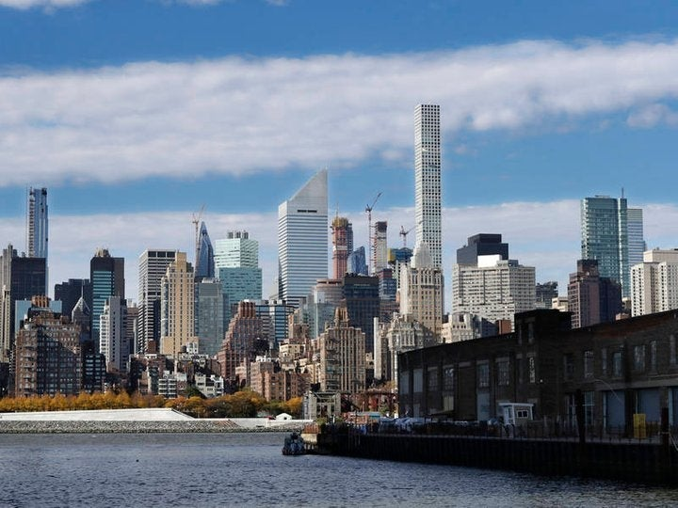
CONCLUSION
This analysis will be very important for individuals who intend to relocate or visit Queens for either business or pleasure but would like to identify the right neighborhood in the borough of. In addition, tourists and real estate agents can benefit from this analysis. The results can be further improved on if neighborhood attribute information is available for all the data instance of type of business, cost of doing business data from other years is also analyzed and average cost of houses in each of the neighborhood is put into consideration as part of the analysis.

Slide 12
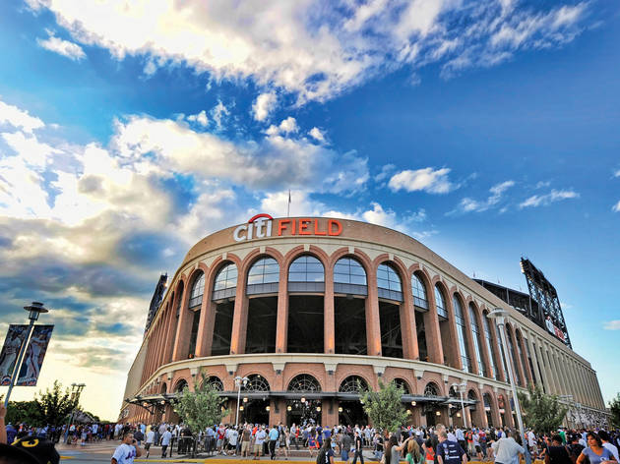
THANK YOU!
OLUSOLA ADEKUNLE
Phone
+234 9095810377
Email
olusola.kunle@outlook.com

